Slide 1

Topic : VibeGuard: Low-Cost Embedded Vibration Monitoring System
PBCST504 – MICROCONTROLLERS
MICRO PROJECT
Final Review

Slide 2
Topic : VibeGuard: Low-Cost Embedded Vibration Monitoring System
Title:- VibeGuard: Low-Cost Embedded Vibration Monitoring System
Group No: Group 8
Members:
Amith Krishna Das – JEC24CC016
Archa Pramod – JEC24CC023
Nihad P C – JEC24CC044
Sreehari K – JEC24CC055
Sreeprada K S – JEC24CC056
Project Coordinator:
Ms. Sagna L T
Asst. Prof. CSE(CY)

Slide 3
Topic : VibeGuard: Low-Cost Embedded Vibration Monitoring System
DEPARTMENT OF COMPUTER SCIENCE & ENGINEERING
(Cyber Security)
Vision of the Department
To be a globally recognized centre of excellence in Cyber Security education, research and innovation by nurturing ethical professionals , fostering technological advancement through responsible practice and contributing to a secure and sustainable digital society.

Slide 4
.
Topic : VibeGuard: Low-Cost Embedded Vibration Monitoring System
DEPARTMENT OF COMPUTER SCIENCE & ENGINEERING
(Cyber Security)
Mission of the Department
M1: Excellence in Education : To provide outcome-based and industry-oriented education by integrating core computer science principles with advanced cybersecurity technologies and practices.
M2: Ethics and Professional Responsibility : To cultivate ethical values, integrity, social responsibility, and secure computing practices for protecting digital assets and strengthening cyber trust.
M3: Research, Innovation, and Entrepreneurship : To promote research, innovation, and entrepreneurial thinking for developing sustainable solutions to emerging cybersecurity challenges.
M4: Holistic and Global Development : To enhance leadership, teamwork, lifelong learning, and global competence through industry collaboration, interdisciplinary activities, and community engagement.

Slide 5
Topic : VibeGuard: Low-Cost Embedded Vibration Monitoring System
Programme Educational Objectives (PEOs)
PEO 1: Graduates will apply strong foundations in computer science and cybersecurity to design, develop, and manage secure and reliable computing systems for industry and society.
PEO 2: Graduates will pursue successful careers as professionals, innovators or entrepreneurs engaged in technology development, deployment or engineering system implementation in industry and society and contribute to the economic growth of the country.
PEO 3: Graduates will demonstrate ethical responsibility, leadership, teamwork, and effective communication while adapting to evolving global technological environments through lifelong learning.

Slide 6
Topic : VibeGuard: Low-Cost Embedded Vibration Monitoring System
Programme Outcomes
Engineering Graduates will be able to:
1. Engineering knowledge: Apply the knowledge of mathematics, science, engineering fundamentals, and an engineering specialization to the solution of complex engineering problems.
2. Problem analysis: Identify, formulate, review research literature, and analyze complex engineering problems reaching substantiated conclusions using first principles of mathematics, natural sciences, and engineering sciences.
3. Design/development of solutions: Design solutions for complex engineering problems and design system components or processes that meet the specified needs with appropriate consideration for the public health and safety, and the cultural, societal, and environmental considerations.
4. Conduct investigations of complex problems: Use research-based knowledge and research methods including design of experiments, analysis and interpretation of data, and synthesis of the information to provide valid conclusions.
5. Modern tool usage: Create, select, and apply appropriate techniques, resources, and modern engineering and IT tools including prediction and modeling to complex engineering activities with an understanding of the limitations.

Slide 7
Topic : VibeGuard: Low-Cost Embedded Vibration Monitoring System
6. The engineer and society: Apply reasoning informed by the contextual knowledge to assess societal, health, safety, legal and cultural issues and the consequent responsibilities relevant to the professional engineering practice.
7. Environment and sustainability: Understand the impact of the professional engineering solutions in societal and environmental contexts, and demonstrate the knowledge of, and need for sustainable development.
8. Ethics: Apply ethical principles and commit to professional ethics and responsibilities and norms of the engineering practice.
9. Individual and team work: Function effectively as an individual, and as a member or leader in diverse teams, and in multidisciplinary settings.
10. Communication: Communicate effectively on complex engineering activities with the engineering community and with society at large, such as, being able to comprehend and write effective reports and design documentation, make effective presentations, and give and receive clear instructions.
11. Project management and finance: Demonstrate knowledge and understanding of the engineering and management principles and apply these to one’s own work, as a member and leader in a team, to manage projects and in multidisciplinary environments.
12. Life-long learning: Recognize the need for, and have the preparation and ability to engage in independent and life-long learning in the broadest context of technological change.

Slide 8
Topic : VibeGuard: Low-Cost Embedded Vibration Monitoring System
Programme Specific Outcomes (PSOs)
On the completion of Computer Science & Engineering program, the students will possess:
PSO 1: Apply cyber security principles to mitigate cyber risk and analyze security requirements of an organization.
PSO 2: Develop and deploy secure software and infrastructure using modern tools and industry standards.
PSO 3: Uphold ethical, legal, and societal responsibilities while protecting privacy, data, and digital assets.

Slide 9
Topic : VibeGuard: Low-Cost Embedded Vibration Monitoring System
CONTENTS
Motivation
Introduction
Problem Statement
Proposed Method
Basic Block Diagram
Detailed Block Diagram
Components Required
Circuit Diagram
Result
Conclusion
References

Slide 10
Motivation
Topic : VibeGuard: Low-Cost Embedded Vibration Monitoring System
Cost & Accessibility: Commercial vibration-monitoring systems can be expensive for small machines, labs and low-cost setups.
Need for Measurable Awareness: Vibration changes can provide measurable evidence that a machine's operating condition has changed.
Limits of Manual Observation: Small vibration changes may be difficult to judge consistently by sound or touch.
Low-Cost Opportunity: VibeGuard explores local vibration monitoring using an affordable accelerometer and microcontroller.

Slide 11
Introduction
Topic : VibeGuard: Low-Cost Embedded Vibration Monitoring System
Project Idea: VibeGuard is a low-cost embedded system for monitoring vibration from a small rotating machine.
Main Goal: Distinguish a documented Normal condition from a controlled Abnormal vibration condition.
Prototype: One rigidly mounted ADXL345-class tri-axis accelerometer and one ESP32 perform local sensing and processing.
Local Operation: RGB indication and USB logging provide the system's local output without cloud dependency.

Slide 12
Problem Statement
Topic : VibeGuard: Low-Cost Embedded Vibration Monitoring System
Monitoring Cost: Commercial continuous vibration monitoring may be too expensive or complex for small machines and educational setups.
Manual Detection: Small vibration changes can be difficult to judge consistently and provide no numerical record.
Engineering Hypothesis: A low-cost embedded system can distinguish a documented Normal condition from a safe controlled Abnormal vibration condition.

Slide 13
Proposed Method
Topic : VibeGuard: Low-Cost Embedded Vibration Monitoring System
Sensor: One rigidly mounted ADXL345-class tri-axis accelerometer measures vibration.
Controller: ESP32 reads acceleration data through SPI.
Processing: DC/mean removal prepares the vibration signal for analysis.
Decision: RMS + persistence forms the minimum Normal/Abnormal decision method.
Supporting Analysis: Triggered FFT provides supporting frequency-domain information.
Output: RGB state indication and structured USB logging.
Test Rig: A guarded low-voltage motor/fan rig provides controlled Normal and Abnormal conditions.

Slide 14
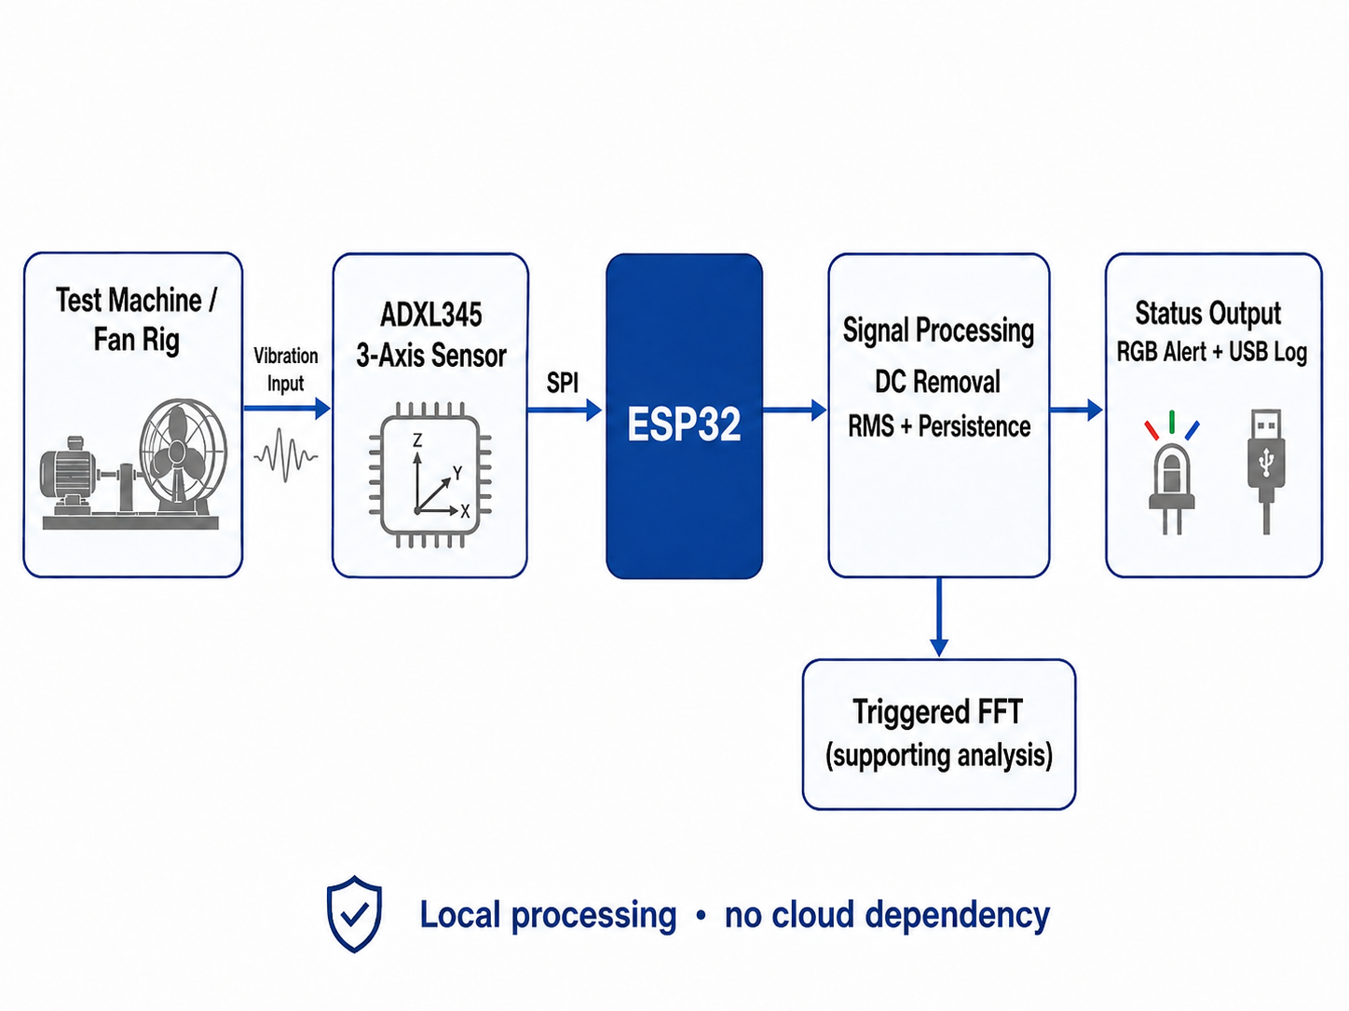
Basic Block Diagram
Topic : VibeGuard: Low-Cost Embedded Vibration Monitoring System

Slide 15
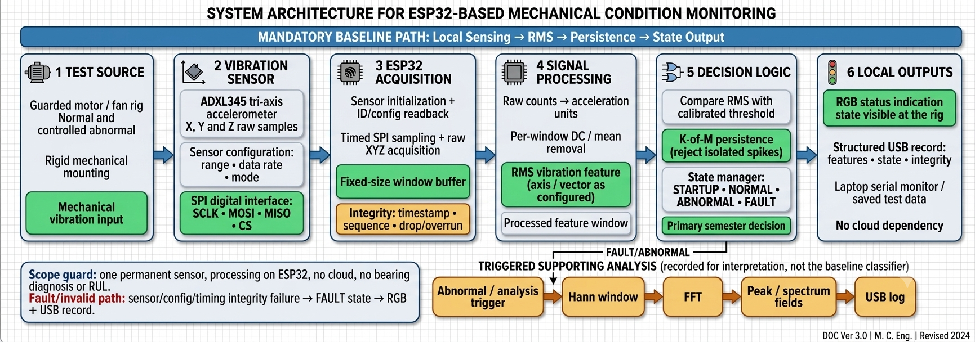
Detailed Block Diagram
Topic : VibeGuard: Low-Cost Embedded Vibration Monitoring System

Slide 16
Topic : VibeGuard: Low-Cost Embedded Vibration Monitoring System
Components Required
Component | Purpose
ESP32 development board | Main controller for reading sensor data and processing logic
ADXL345 accelerometer | Measures vibration in 3 axes
RGB LED | Indicates machine condition visually
Resistors | Current limiting for LED connections
Breadboard / PCB | Prototype assembly
Components | Purpose
Jumper wires | Electrical interconnection
USB cable | Power and serial communication
DC motor / small rotating machine | Vibration source for testing
Mounting base / clamp | Fixing the sensor and test object
Laptop with Arduino IDE / serial monitor | Programming and logging

Slide 17
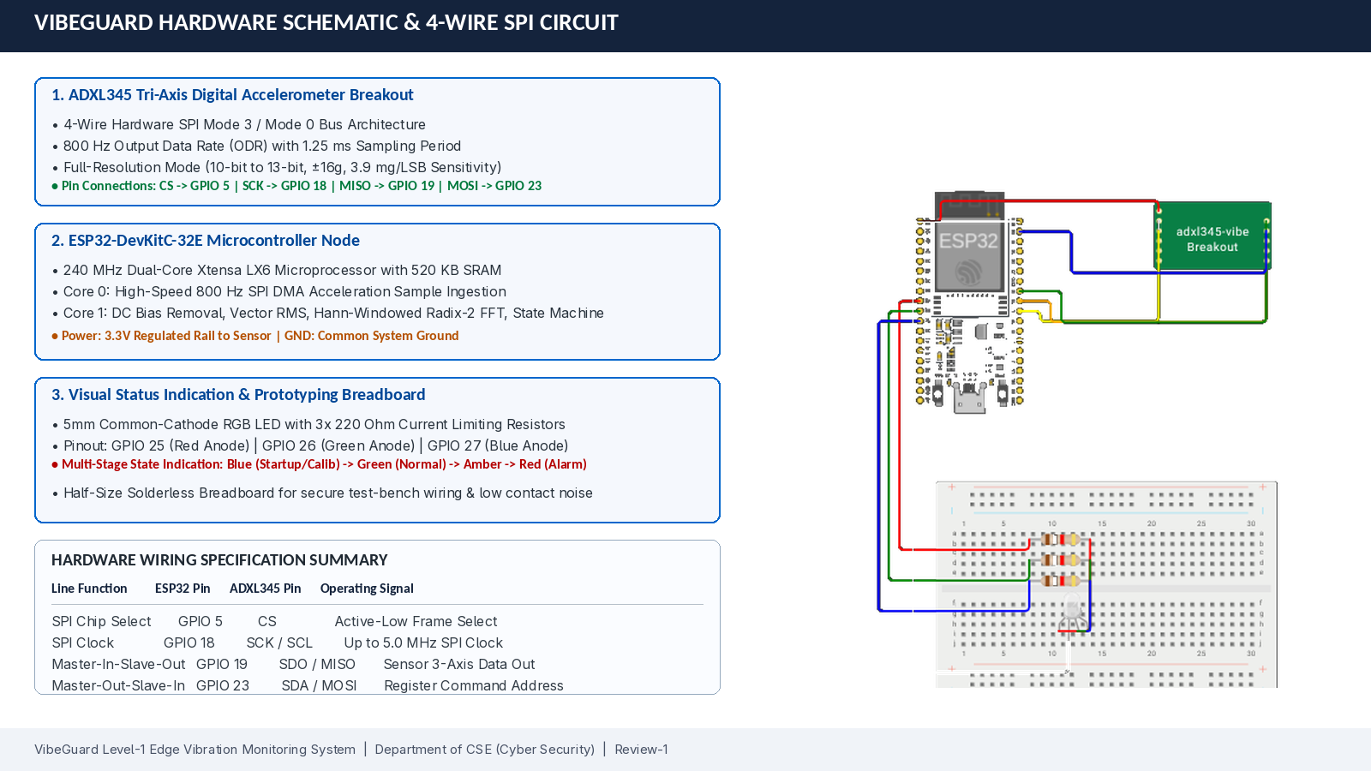
Circuit Diagram
Topic : VibeGuard: Low-Cost Embedded Vibration Monitoring System

Slide 18
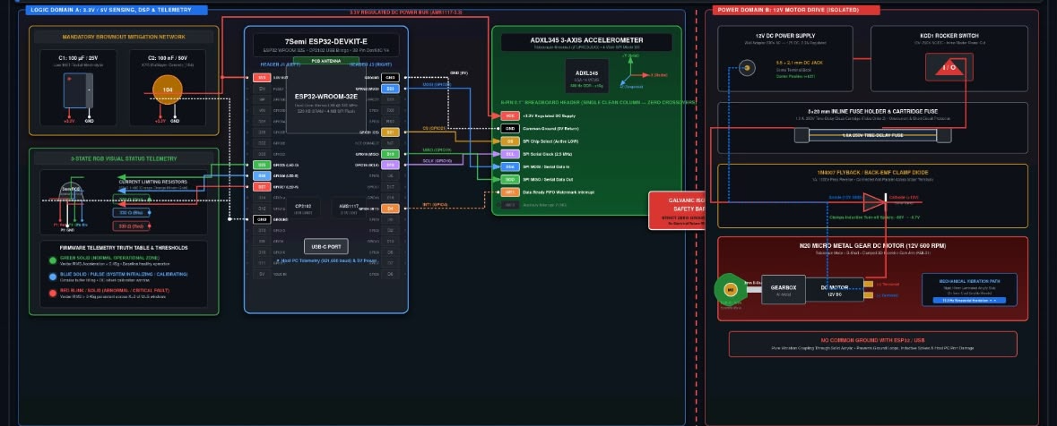
Circuit Diagram
Topic : VibeGuard: Low-Cost Embedded Vibration Monitoring System

Slide 19
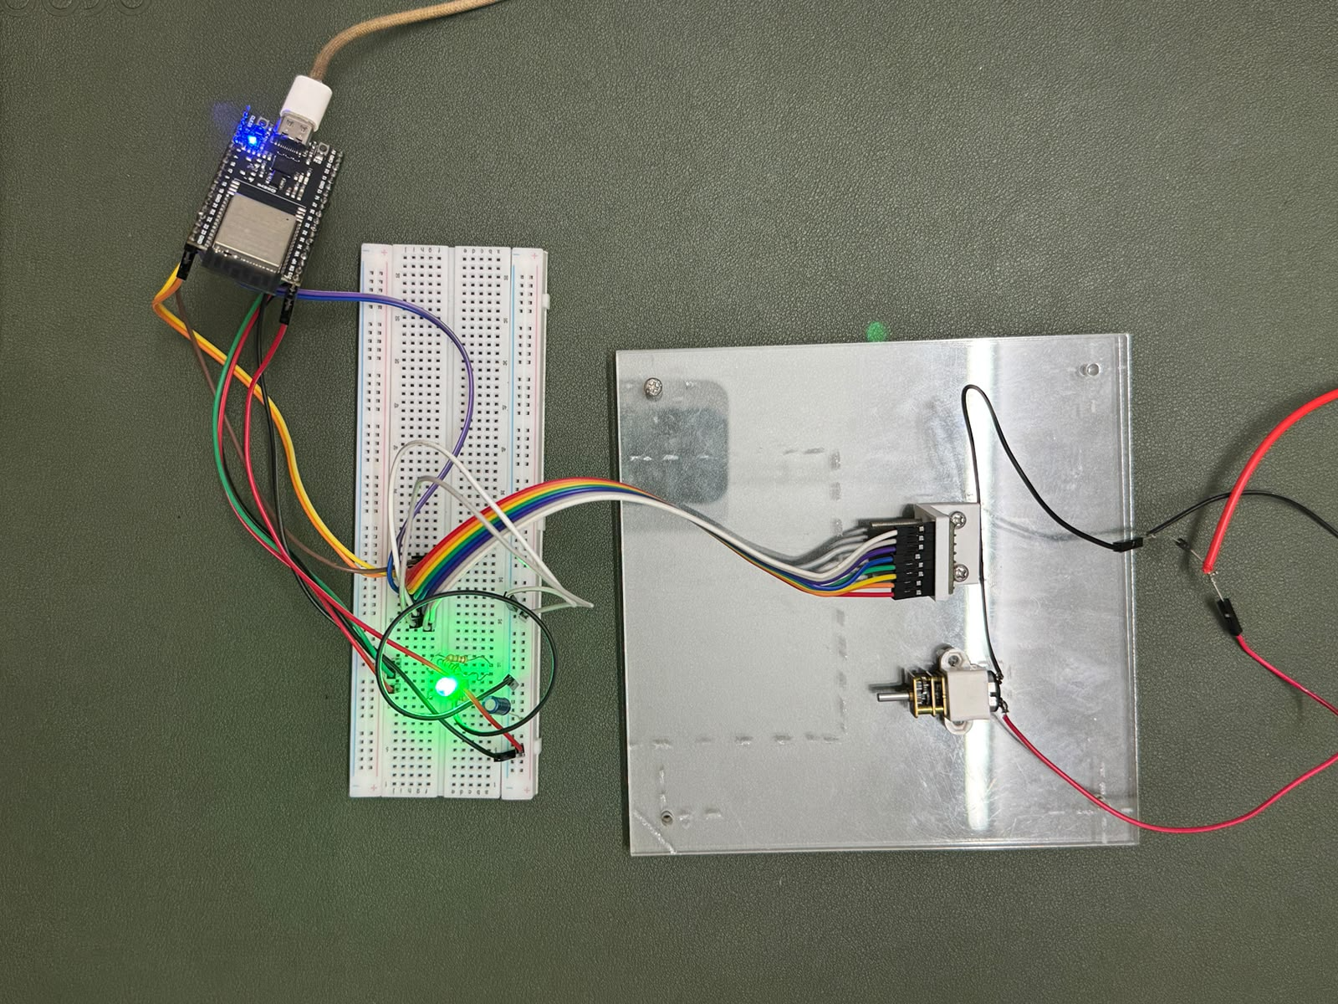
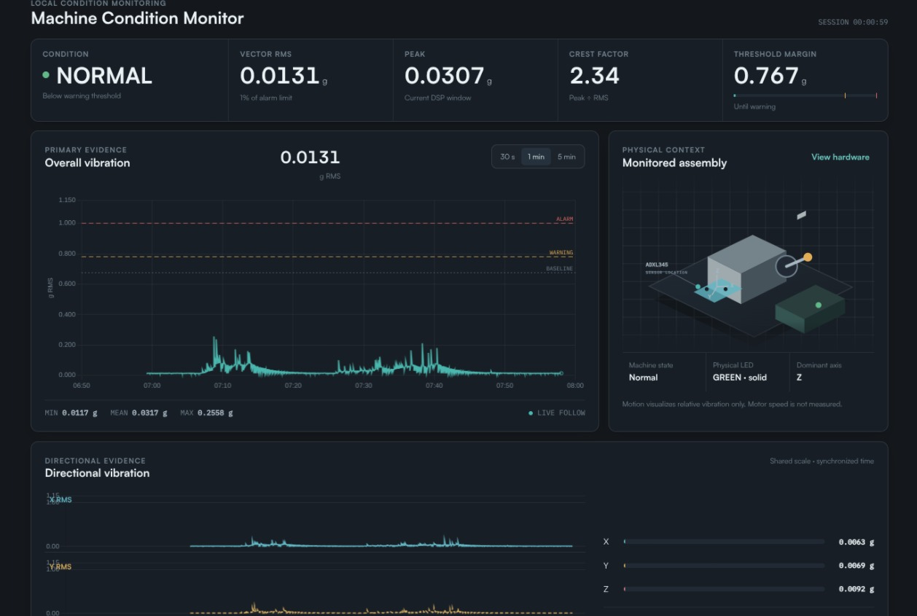
Result
Topic : VibeGuard: Low-Cost Embedded Vibration Monitoring System
.

Slide 20
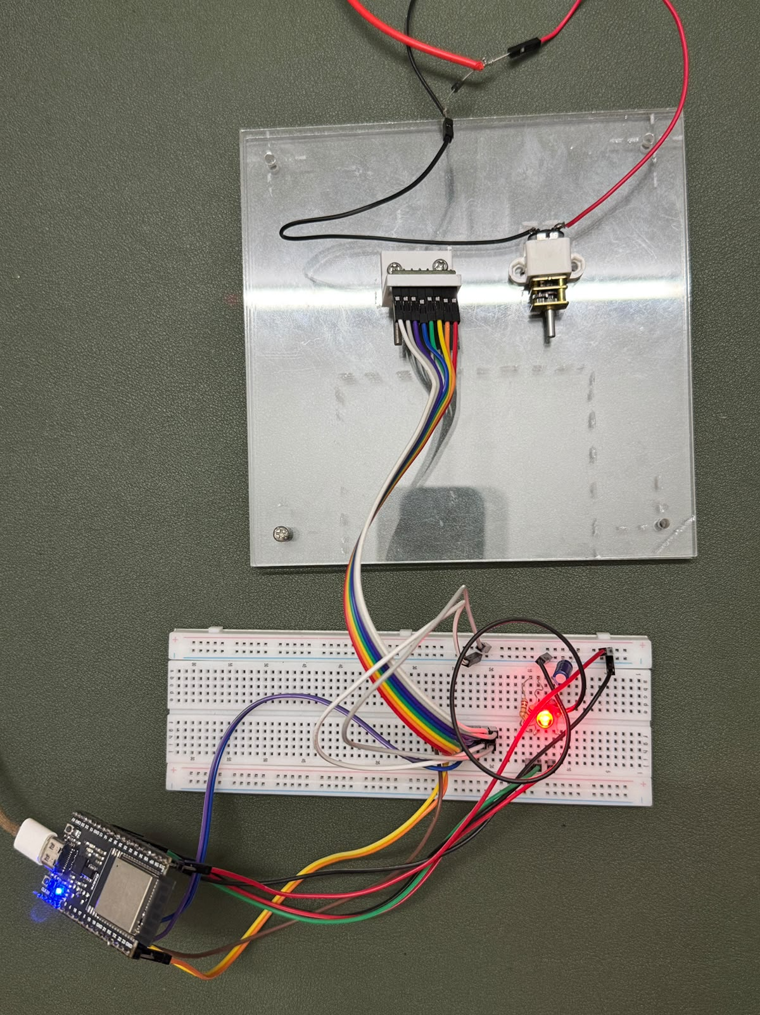
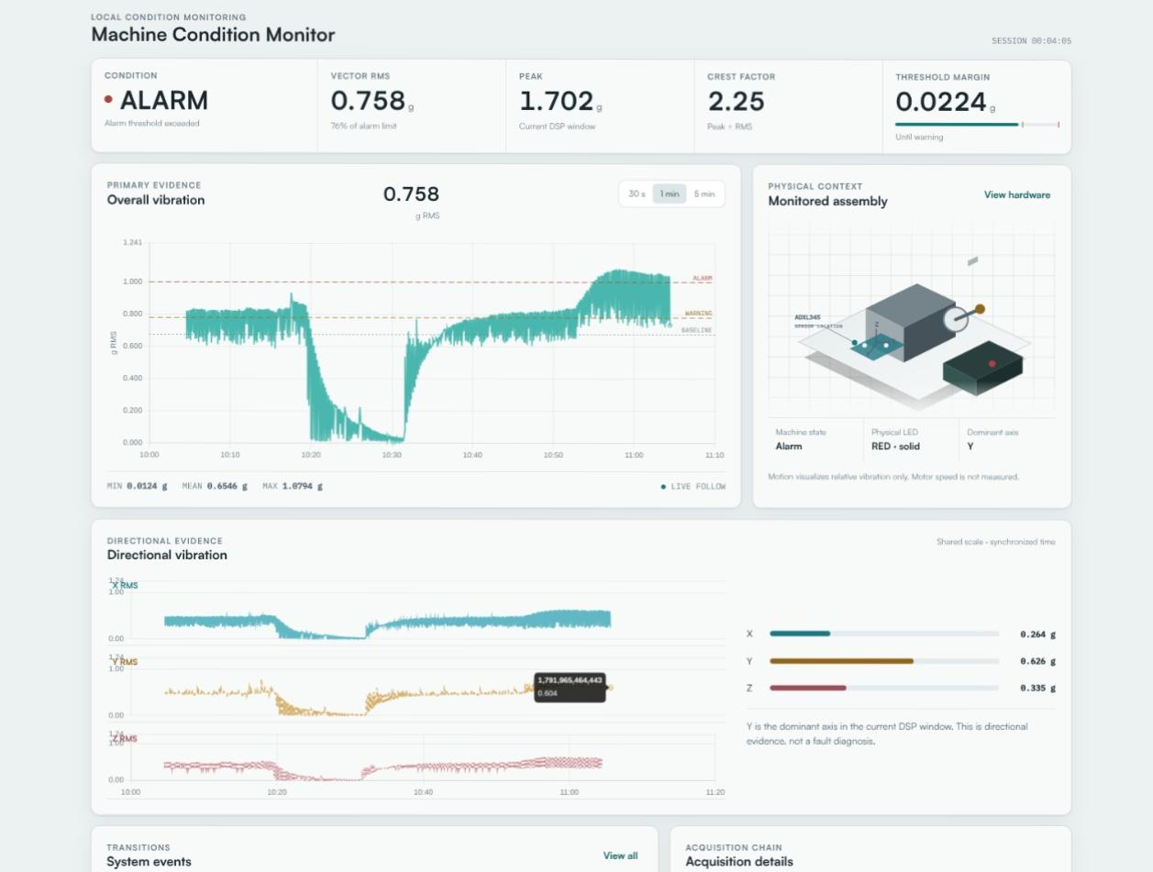
Topic : VibeGuard: Low-Cost Embedded Vibration Monitoring System

Slide 21
Conclusion
Topic : VibeGuard: Low-Cost Embedded Vibration Monitoring System
Prototype Proposal: VibeGuard uses one ADXL345-class accelerometer and an ESP32 for low-cost vibration monitoring.
Semester Goal: Distinguish a documented Normal state from a safe controlled Abnormal vibration state.
Processing: RMS + persistence provides the minimum decision method, supported by triggered FFT.
Expected Output: RGB state indication and structured USB logs.
Validation: The prototype still has to be built and tested; no final accuracy or industrial fault-diagnosis claim is being made yet.
Cost Estimate: Preferred budget ≤ ₹3,000; maximum budget ≤ ₹5,000; development period: approximately 3 months; team: 5 students.

Slide 22
References
Topic : VibeGuard: Low-Cost Embedded Vibration Monitoring System
1. ISO 10816-1: Mechanical vibration — Evaluation of machine vibration by measurements on non-rotating parts, ISO Standard.
2. Analog Devices: ADXL345 3-Axis, ±2g/±4g/±8g/±16g Digital Accelerometer Datasheet, Rev. E, 2015.
3. Espressif Systems: ESP32 Series Technical Reference Manual & Datasheet, v4.3, 2023.
4. Cooley, J. W., & Tukey, J. W.: "An algorithm for the machine calculation of complex Fourier series", Math. Comput., 1965.
5. Randall, R. B.: Vibration-based Condition Monitoring: Industrial, Automotive and Aerospace Applications, Wiley, 2011.

